Slide 1
RESTAURANT SALES ANALYSIS
USING SQL

Slide 2
INTRODUCTION
OBJECTIVES
Analyze Restaurant Sales Data Using SQL
GOALS
Understand sales trends
Identify top-selling items
Analyze revenue and customer behavior

Slide 3

QUESTION 1
--1. View the menu_items table and write a query to find the number of items on the menu SELECT COUNT(*) AS number_of_items FROM menu_items

Slide 4


QUESTION 2
--2. What are the least and most expensive items on the menu?
--most expensive item
SELECT item_name, price
FROM menu_items
ORDER BY price DESC
LIMIT 1
--least expensive item
SELECT item_name, price
FROM menu_items
ORDER BY price
LIMIT 1

Slide 5



QUESTION 3
--3. How many Italian dishes are on the menu? What are the least and most expensive Italian dishes on the menu?
SELECT COUNT(*) AS number_of_italian_dishes
FROM menu_items
WHERE category = 'Italian'
SELECT category,item_name AS most_italian_dish, price
FROM menu_items
WHERE category = 'Italian'
ORDER BY price DESC
LIMIT 1
SELECT category,item_name AS least_italian_dish, price
FROM menu_items
WHERE category = 'Italian'
ORDER BY price
LIMIT 1

Slide 6
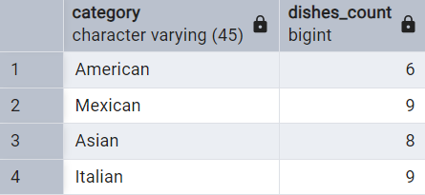
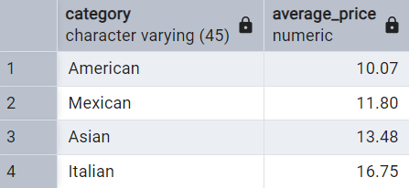
QUESTION 4
--4. How many dishes are in each category? What is the average dish price within each category?
SELECT category, COUNT(*) AS dishes_count
FROM menu_items
GROUP BY category
SELECT category, ROUND(AVG(price),2) AS average_price
FROM menu_items
GROUP BY category

Slide 7

QUESTION 5
--5. View the order_details table. What is the date range of the table?
SELECT * FROM order_details
SELECT
MIN(order_date) AS earliest_date,
MAX(order_date) AS latest_date
FROM
order_details

Slide 8

QUESTION 6
--6. How many orders were made within this date range? How many items were ordered within this date range?
SELECT COUNT (order_id) AS Number_of_orders, COUNT(item_id) AS items_ordered
FROM order_details
WHERE order_date BETWEEN '2023-01-01' AND '2023-03-31'

Slide 9
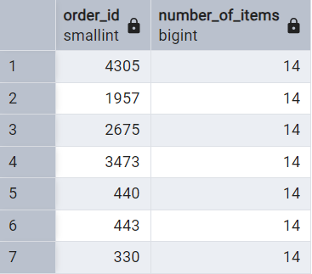
QUESTION 7
--7. Which orders had the most number of items?
SELECT order_id, COUNT(item_id) AS number_of_items
FROM order_details
GROUP BY order_id
ORDER BY COUNT(item_id) DESC
LIMIT 7

Slide 10

QUESTION 8
--8. How many orders had more than 12 items?
SELECT COUNT (*) AS orders_more_than_12
FROM (SELECT order_id, COUNT(item_id) AS number_of_items
FROM order_details
GROUP BY order_id
HAVING COUNT(item_id) > 12)

Slide 11
QUESTION 9
--9. Combine the menu_items and order_details tables into a single table
SELECT * FROM order_details od
JOIN menu_items mi ON od.item_id = mi.menu_item_id

Slide 12


QUESTION 10
10. What were the least and most ordered items? What categories were they in?
--most
SELECT mi.category, mi.item_name, COUNT(DISTINCT order_id) AS Ordered_items
FROM order_details od
JOIN menu_items mi ON od.item_id = mi.menu_item_id
GROUP BY mi.category, mi.item_name
ORDER BY ordered_items DESC
LIMIT 1
--least
SELECT mi.category, mi.item_name, COUNT(DISTINCT order_id) AS Ordered_items
FROM order_details od
JOIN menu_items mi ON od.item_id = mi.menu_item_id
GROUP BY mi.category, mi.item_name
ORDER BY ordered_items
LIMIT 1

Slide 13
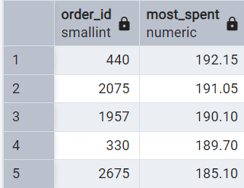
QUESTION 11
11.What were the top 5 orders that spent the most money?
SELECT od.order_id, SUM(price) AS most_spent
FROM order_details od JOIN menu_items mi ON mi.menu_item_id = od.item_id
GROUP BY od.order_id
ORDER BY SUM(price) DESC
LIMIT 5

Slide 14

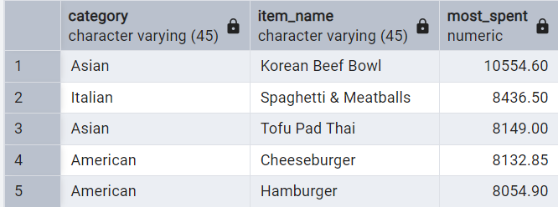
QUESTION 12
--12. View the details of the highest spend order. Which specific items were purchased?
SELECT category, item_name, od.order_id, SUM(price) AS most_spent
FROM order_details od JOIN menu_items mi ON mi.menu_item_id = od.item_id
GROUP BY category, item_name, od.order_id
ORDER BY SUM(price) DESC
LIMIT 1
SELECT category, item_name, SUM(price) AS most_spent
FROM order_details od JOIN menu_items mi ON mi.menu_item_id = od.item_id
GROUP BY category, item_name
ORDER BY SUM(price) DESC
LIMIT 5

Slide 15
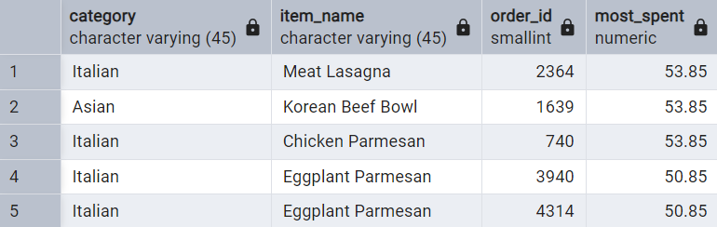
QUESTION 13
--13. View the details of the top 5 highest spend orders
SELECT category, item_name, od.order_id, SUM(price) AS most_spent
FROM order_details od JOIN menu_items mi ON mi.menu_item_id = od.item_id
GROUP BY category, item_name, od.order_id
ORDER BY SUM(price) DESC
LIMIT 5

Slide 16
REPORTS & INSIGHTS
• Sales Summary Report:
Total revenue, number of orders, average order value
• Customer Insights:
- Most frequent customers, high-value customers
• Popular Items:
- Most ordered dishes, seasonal trends
• Recommendations:
- Optimize menu pricing, target high-value customers

